Slide 1
Amazon Kindle Store Review Analysis Using IBM Cloud Services
Done by:
Aditya Deepak Joshi 19BCE0257 (adityadeepak.joshi2019@vitstudent.ac.in)
Abhinav Gorantla 19BCE0241 (abhinav.gorantla2019@vitstudent.ac.in)
V L Rishi 19BCE7553 (rishi.19bce7553@vitap.ac.in)
Atharva Ramgirkar 19BCE0114 (atharva.ramgirkar2019@vitstudent.ac.in)

Slide 2
Index
Introduction
Problem Statement
Solution
Literature Survey
Experimental Investigations
Hardware and Software Specifications
Flowchart
Conclusion
Future Scope
Bibliography

Slide 3
Introduction
With the rise of technology, user can directly give reviews about products, brands etc. These reviews play vital role in online shopping as well as help people to determine whether a product is good or not.
Huge amount of text data related to user opinions about products and services are generated every day in the world. But it is not feasible to analyze the sentiment of these vast of texts manually. So, an automated process must be applied to mine these text data and analyze the sentiment effectively as the companies need to use these numerous amounts of data to improve their businesses by drawing more effective marketing analysis, product reviews, public relations etc.

Slide 4
Problem Statement
Amazon Kindle Store is an e-book e-commerce store for all the book reading hobbyists. Online reviews are a category of product information created by users based on personal handling experience. Online shopping websites endow with platforms for consumers to review products and carve up opinions. The problem is most of the comments from customer reviews about the products are contradicted to their ratings. Many customers will post their comments and forgot to rate the product or not engrossed to rate it.
Sentiment mining plays a very important role in business to understand the opinion of customers to improve the products. Customer also depends on the opinion of others who have bought the products already. Reviews or feedback becomes the deciding factor to buy or sell a product. A rating of the products gives a speedy clarification to pact with the product. We will be using Natural language processing to analyse the sentiment (positive or a negative) of the given review.

Slide 5
Solution
1.Importing Libraries: Pandas, numpy, nltk, re, os, tensorflow, keras
2.Reading the Dataset: Filter out null and redundant values
3.Data preprocessing: Encode 0 for positive reviews and 1 for negative reviews
4.Building models: Train test split, input, output, hidden layers
5.Predictions and testing the model: based on keywords, answer is given

Slide 6
Literature Survey
Earlier, various rule-based approaches have been used for sentiment analysis. For example, Hutto and Gilbert [1] presented a simple rule-based model for general sentiment analysis and found better performance than the benchmarks used in their study. But the performance of their proposed model was not compared with neural network based approaches. Popular Social Media website like Twitter has also been used for sentiment analysis. Agarwal et al.examined sentiment analysis on Twitter data by introducing Parts of Speech (POS) features.
Later, Kouloumpis et al. [2] investigated the utility of linguistic features for detecting the sentiment of Twitter messages and showed that part-of-speech features is not useful for sentiment analysis in the microblogging domain. Wilson et al. [3] presented a new approach to phrase-level sentiment analysis that first determined whether an expression was neutral or polar, and then disambiguated the polarity of the polar expressions.
Different techniques in combination with sentiment analysis algorithms have also been applied. Liu et al. [4] applied sentiment analysis models for predicting the helpfulness of reviews, which provides the basis for discovering the most helpful reviews for given products.
Reviewers review history was also considered by some researchers. For example, Basiri et al. [5] considered the comment histories of reviewers and found that their proposed system performed better than different algorithms. But they only compared their model with Machine Learning based algorithms and did not compare the performance of their proposed model with neural network-based approaches.

Slide 7
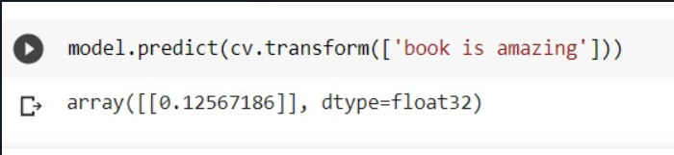
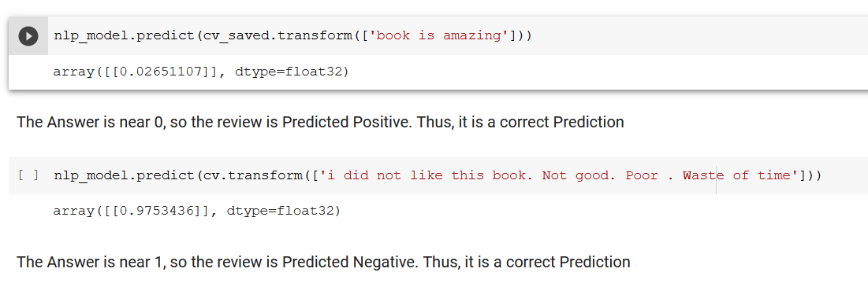
Experimental Investigations
We tested the model by using only 10000 values and here is the result:
When we used nearly 1 million values, we got this:
Since we used lesser values for the first case, we got a score closer to 1 than the second case.
This leads to an inaccurate review score as the keywords indicate a positive review.
Hence we inferred that increase in values will lead to better and more accurate scores of reviews as there are more keywords to analyze.

Slide 8
Hardware and Software Specifications
Hardware specifications used:
1.Processor: Intel® Core™ i5-8250 CPU @ 1.60 GHZ 1.80 GHz
2.Installed RAM: 8.00 GB
3.System type: 64 bit operating system, x64-based processor
Software specifications used:
1.OS: Windows 10 Home Single Language, build: 19043.1110, version: 21H1
2.For model building: Google Colab(python), Microsoft excel file for datasets, Keras and Tensorflow for making ML based projects.
3.For app building: HTML, CSS used to make webpages, Flask used for building web applications.

Slide 9
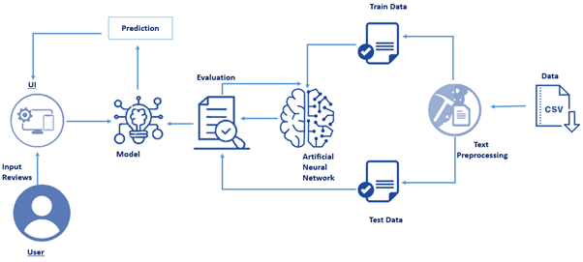
Flowchart

Slide 10
Conclusion
Thus, the project has been done and the results are as follows:
Case A:
When we use the keywords “book is amazing” we get the result:
Case B:
When we use the keywords “i did not like this book. Not good. Poor . Waste of time” we get this result:
We have previously defined that a score of 0 means the review is positive and a score of 1 means the review is negative.
In Case A, the score generated is closer to 0, thus indicating that the review is positive.
In Case B, the score generated is closer to 1, thus indicating that the review is negative.
Thus, the prediction by the model is right and works properly.

Slide 11
Future Scope
The basis of this project can be used in larger scale applications handling millions of customer reviews for any product in an online shopping website or even reviews about a particular service like restaurants, car repair shop, etc.
The accuracy and range of detection can be expanded upon by including more reviews with keywords and have a broader score range for different levels of customer satisfaction.

Slide 12
Bibliography
[1] Hutto, C., & Gilbert, E. (2014). VADER: A Parsimonious Rule-Based Model for Sentiment Analysis of Social Media Text. In International AAAI Conference on Weblogs and Social Media, AAAI, 216-225.
[2] Kouloumpis, E., Wilson, T. & Moore, J., (2011). Twitter Sentiment Analysis: The Good the Bad and the OMG! In Proceedings of the Fifth International Conference on Weblogs and Social Media, 538-541.
[3] Basiri, M., Ghasem-Aghae, N., & Naghsh-Nilchi, A. (2014). Exploiting reviewers’ comment histories for sentiment analysis. Journal of Information Science, 40(3), 313-328.
[4] Wilson, T., Wiebe, J., & Hoffmann, P. (2005). Recognizing contextual polarity in phrase-level sentiment analysis. In Proceedings of the conference on Human Language Technology and Empirical Methods in
Natural Language Processing, HLT '05, ACL, 347-354.
[5] Liu, Y., Huang, X., An, A., & Yu, X. (2008). Modeling and Predicting the Helpfulness of Online Reviews, in Eighth IEEE International Conference on Data Mining, Pisa, 443-452.

